Slide 1
UNIT - II Artificial Neural networks

Slide 2
UNIT - II
Artificial Neural Networks-1– Introduction, neural network representation, appropriate problems for neural network learning, perceptions, multilayer networks and the back-propagation algorithm.
Artificial Neural Networks-2- Remarks on the Back-Propagation algorithm, An illustrative example: face recognition, advanced topics in artificial neural networks.
Evaluation Hypotheses – Motivation, estimation hypothesis accuracy, basics of sampling theory, a general approach for deriving confidence intervals, difference in error of two hypotheses, comparing learning algorithms.

Slide 3
TOPICS
1. Artificial Neural Networks
1.1. Neurons and Biological Motivation
1.2. Neural Network Representations
1.3. Problems for Neural Network Learning
2. Perceptrons
2.1. Representational Power of Perceptrons
2.2. The Perceptron Training Rules
3. Multilayer Networks and the Back Propagation Algorithm
3.1. A Differentiable Threshold Unit
3.2. The Backpropagation Algorithm

Slide 4
1. Artificial Neural Networks
Neural network learning methods provide a robust approach to approximating real-valued, discrete-valued and vector-valued target functions.
ANN learning is well matched for certain types of problems, like:
Interpret complex real-world sensor data.
Speech recognition.
Visual scenes.
Learning robot control strategies. etc…

Slide 5
1. Artificial Neural Networks (Continued)
The Backpropagation algorithm is one of the efficient ANN algorithm , which is successful in many practical problems such as:
Learning to recognize handwritten characters
Learning to recognize faces
Learning to recognize spoken words
The Backpropagation algorithm use gradient descent to tune network parameters to best fit a training set of input-output pairs.

Slide 6
1.1. Neurons and Biological Motivation
The study of artificial neural network(ANN) has been inspired by the observation that biological learning systems are built of very high complex, nonlinear parallel interconnections of neurons.
The human body is made up of trillions of cells. Cells of the nervous system, called nerve cells or neurons, are specialized to carry "messages" through an electrochemical process.

Slide 7
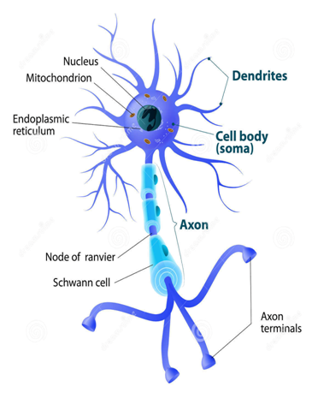
1.1. Neurons and Biological Motivation (Continued)
Neurons have specialize cell part called dendrites and
axons. Dendrites bring electrical signals to the cell body and axons take information away from the cell body.
To a neuron dendrites are used to take input to neuron cell and axons are used to give output from that neuron cell , which may input to another neuron.

Slide 8
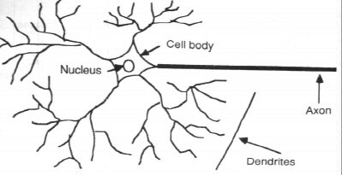
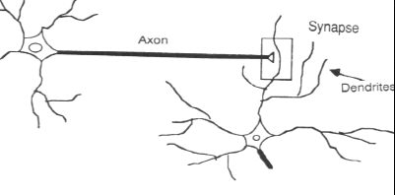
1.1. Neurons and Biological Motivation (Continued)
A Neuron structure
Communication between two neurons

Slide 9
1.1. Neurons and Biological Motivation (Continued)
The human brain , is estimated to contain an interconnected network of approximately 10¹¹ neurons, each connected, on average, to 10⁴ others.
Neuron activity is typically excited through connections to other neurons.
Signals can be transmitted unchanged or they can be altered by synapses. A synapse is able to increase or decrease the strength of the connection from the neuron to neuron and cause excitation or inhibition of a subsequence neuron. This is where information is stored.
ANNs are loosely motivated by biological neural systems, there are many complexities to biological neural systems that are not modeled by ANNs.

Slide 10
1.1. Neurons and Biological Motivation (Continued)
The information processing abilities of biological neural systems must follow from highly parallel processes operating on representations that are distributed over many neurons. One motivation for ANN is to capture this kind of highly parallel computation based on distributed representations.
Historically, two groups of researchers have worked with artificial neural networks.
ANNs to study and model biological learning processes.
To obtaining highly effective machine learning algorithms

Slide 11
1.2. Neural Network Representations
A prototypical example of ANN learning is ALVINN( (Autonomous Land Vehicle In a Neural Network)is a perception system, which uses a learned ANN to steer an autonomous vehicle driving at normal speeds on public highways.
Input: The input to the neural network is a 30 x 32 grid of pixel intensities obtained from a forward-pointed camera mounted on the vehicle.
Output: The network output is the direction in which the vehicle is steered

Slide 12
1.2. Neural Network Representations (Continued)
The ANN is trained to mimic the observed steering commands of a human driving the vehicle for approximately 5 minutes. ALVINN has used its learned networks to successfully drive at speeds up to 70 miles per hour and for distances of 90 miles on public highways.
Figures in the next slide illustrates the neural network representation used in one version of the ALVINN system, and illustrates the kind of representation typical of many ANN systems.

Slide 13
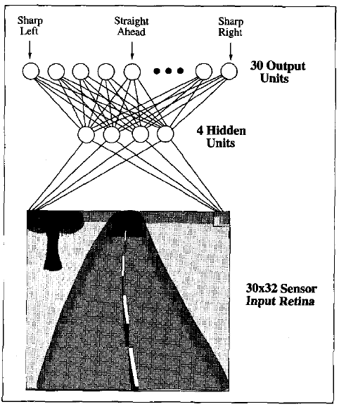
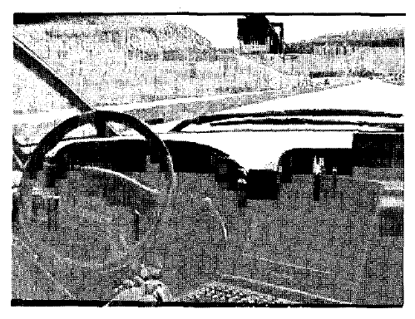
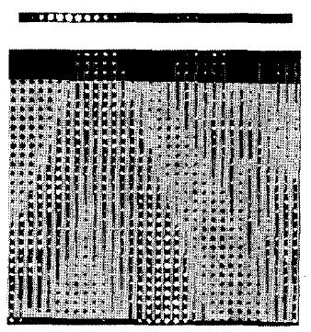
1.2. Neural Network Representations (Continued)
Figure 2
Figure 3
Figure 1

Slide 14
1.2. Neural Network Representations (Continued)
The ALVINN system uses BACKPROPAGATION to learn to steer an autonomous vehicle (photo at top) driving at speeds up to 70 miles per hour.
The diagram on the left (figure 1) shows how the image of a forward-mounted camera is mapped to 960 neural network inputs, which are fed forward to 4 hidden units, connected to 30 output units.
The figure 3 shows 30 x 32 weights into the hidden unit are displayed in the large matrix, with white blocks indicating positive and black indicating negative weights.
As can be seen from these output weights, activation of this particular hidden unit encourages a turn toward the left.

Slide 15
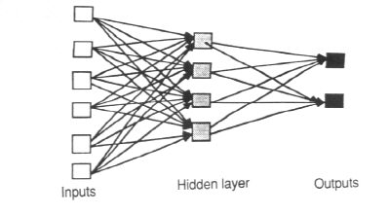
1.2. Neural Network Representations (Continued)
Each ANN is composed of a collection of perceptrons grouped in layers. A typical structure is shown in below figure.
Note the three layers: input, intermediate (called the hidden layer) and output.
Several hidden layers can be placed between the input and output layers.

Slide 16
1.3. Problems for Neural Network Learning
ANN learning is well-suited to problems in which the training data corresponds to noisy, complex sensor data. It is also applicable to problems for which more symbolic representations are used.
The back propagation (BP) algorithm is the most commonly used ANN learning technique. It is appropriate for problems with the characteristics:

Slide 17
1.3. Problems for Neural Network Learning (Continued)
Instances are represented by many attribute-value pairs.
The target function output may be discrete-valued, real-valued, or a vector of several real- or discrete-valued attributes.
The training examples may contain errors.
Long training times are acceptable.
Fast evaluation of the learned target function may be required.
The ability of humans to understand the learned target function is not important

Slide 18
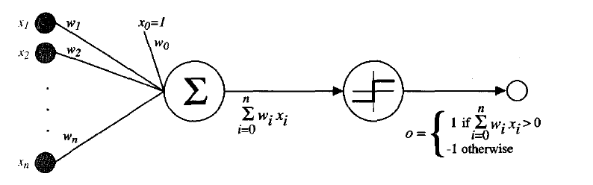
2. Perceptrons
One type of ANN system is based on a unit called a perceptron, illustrated in below figure.
An ANN consists of perceptrons. Each of the perceptrons receives inputs, processes inputs and delivers a single output.
A Perceptron

Slide 19

2. Perceptrons (Continued)
A perceptron takes a vector of real-valued inputs, then calculates a linear combination of these inputs, after that it returns1if the result is greater than some threshold and -1 otherwise as its output.
where each w_{i} is a real-valued constant, or weight, that determines the contribution of input x_{i} to the perceptron output.

Slide 20
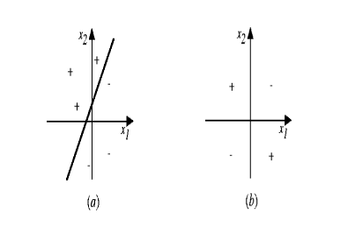
2.1. Representational Power of Perceptrons
We can view the perceptron as representing a hyperplane decision surface in the n-dimensional space of instances (i.e. points).
The perceptron outputs a 1 for instances lying on one side of the hyperplane and outputs a –1 for instances lying on the other side.
Examples can be separated by a single perceptron are called linearly separated set of examples.

Slide 21
2.1. Representational Power of Perceptrons (Continued)
A single perceptron can be used to represent many boolean functions.
For example, if we assume boolean values of 1 (true) and -1 (false), then one way to use a two-input perceptron to implement the AND function is to set the weights wo = -0.8, and w1 = w2 = .5.
This perceptron can be made to represent the OR function instead by altering the threshold to wo =-0.3.
Unfortunately, however, some boolean functions cannot be represented by a single perceptron, such as the XOR function. Those are called linearly nonseparable training examples

Slide 22
2.1. Representational Power of Perceptrons (Continued)
A single perceptron can be used to represent many boolean functions.
AND function(linearly separable) :
Decision hyper plane :
w₀ + w₁ x₁ + w₂ x₂ = 0
-0.8 + 0.5 x₁ + 0.5 x₂ = 0

Slide 23
2.1. Representational Power of Perceptrons (Continued)
OR function (linearly separable):
The two-input perceptron can implement the OR function when we set the weights: w₀ = -0.3, w₁ = w₂ = 0.5 .
Decision hyperplane :
w₀ + w₁ x₁ + w₂ x₂ = 0
-0.3 + 0.5 x₁ + 0.5 x₂ = 0

Slide 24
2.1. Representational Power of Perceptrons (Continued)
XOR function(Non linearly separable) :
It’s impossible to implement the XOR function by a single perception.
A two-layer network of perceptrons can represent XOR function.
Refer to this equation,

Slide 25
2.2. The Perceptron Training Rule
let us begin by understanding how to learn the weights for a single perceptron.
They are important to ANNs because they provide the basis for learning networks of many units.
Several algorithms are known to solve this learning problem. Here we consider two:
The Perceptron rule.
The Delta rule.

Slide 26
2.2. The Perceptron Training Rule (Continued)
The Perceptron Rule:
One way to learn an acceptable weight vector is to begin with random weights, then iteratively apply the perceptron to each training example, modifying the perceptron weights whenever it misclassifies an example.
This process is repeated until the perceptron classifies all training examples correctly.
Weights are modified at each step according to the perceptron training rule , which revises the weight wi associated with input xi according to the rule.
Where ,

Slide 27
2.2. The Perceptron Training Rule (Continued)
In the above equation:
t → is the target output for the current training example
o → is the output generated by the perceptron
and
η→ is a positive constant called the learning rate
The role of the learning rate is to moderate the degree to which weights are changed at each step.

Slide 28
2.2. The Perceptron Training Rule (Continued)
If t = -1 and o = 1, then weights associated with positive xi will be decreased rather than increased.
If t=1 and o=-1 , then weights associated with positive xi will be increased rather than decreased.
Example: if xi = 0.8, η= 0.1, t = 1, and o = - 1, then the weight update will be = O.1(1 - (-1))0.8 = 0.16.
the above learning procedure can be proven to converge within a finite number of applications of the perceptron training rule to a weight vector that correctly classifies all training examples, provided the training examples are linearly separable and provided a sufficiently small n is used. If the data are not linearly separable, convergence is not assured.

Slide 29
2.2. The Perceptron Training Rule (Continued)
Gradient Descent and the Delta Rule:
The perceptron rule finds a successful weight vector when the training examples are linearly separable, it can fail to converge if the examples are not linearly separable.
A second training rule, called the delta rule, is designed to overcome this difficulty.
The key idea of delta rule is to use gradient descent to search the space of possible weight vector to find the weights that best fit the training examples.
This rule is important because gradient descent provides the basis for the BACKPROPAGATION algorithm, it can serve as the basis for learning algorithms that must search through hypothesis spaces containing many different types of continuously parameterized hypotheses.

Slide 30


2.2. The Perceptron Training Rule (Continued)
The delta training rule is best understood by considering the task of training an unthresholded perceptron; that is, a linear unit for which the output o is given by
In order to derive a weight learning rule for linear units, let us begin by specifying a measure for the training error of a hypothesis (weight vector), relative to the training examples. Although there are many ways to define this error, one common measure used is

Slide 31
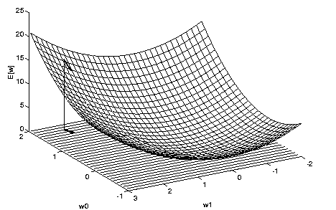
2.2. The Perceptron Training Rule (Continued)
Error of different hypotheses. For a linear unit with two weights, the hypothesis space H is the w0, w1 plane.

Slide 32
2.2. The Perceptron Training Rule (Continued)
Gradient descent search determines a weight vector that minimizes E by starting with an arbitrary initial weight vector, then repeatedly modifying it in small steps.
At each step, the weight vector is altered in the direction that produces the steepest descent along the error surface.
This process continues until the global minimum error is reached

Slide 33

2.2. The Perceptron Training Rule (Continued)
Then , it will update the weights as:
the gradient descent algorithm for training linear units is as follows: Pick an initial random weight vector. Apply the linear unit to all training examples, then compute Δwi for each weight according to Equation Update each weight wi by adding Δwi, then repeat this process.

Slide 34
2.2. The Perceptron Training Rule (Continued)
Derivation of Gradient – Descent Rule:
How can we calculate the direction of steepest descent along the error surface?
This can be done by computing the derivative of E with respect to each component of the vector .
This vector derivative is called the gradient of E with respect to , written .

Slide 35


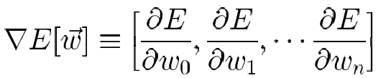
2.2. The Perceptron Training Rule (Continued)
A linear unit for which the output o is given by
-------------- (1)
In order to derive a weight learning rule for linear units, let us begin by specifying a measure for the training error of a hypothesis, one common measure that will turn out to be especially convenient is
--------- (2)
This vector derivative is called the gradient of E with respect to the vector <w₀,…,w_{n}>, written ∇E .
------------(3)

Slide 36


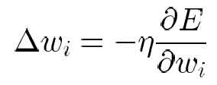
2.2. The Perceptron Training Rule (Continued)
Since the gradient specifies the direction of steepest increase of E, the training rule for gradient descent is
where
----------- (4)
Here is a positive constant called the learning rate.
The negative sign is present because we want to move the weight vector in the direction that decreases E.
Equation 4 can also be written as ------ (5)

Slide 37
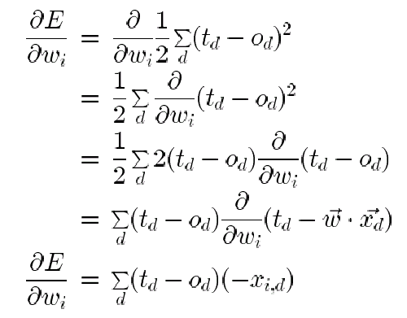
2.2. The Perceptron Training Rule (Continued)
which makes it clear that steepest descent is achieved by altering each component w_{i} of weight vector in proportion to ∂E/∂w_{i}.The vector of ∂E/∂w_{i} derivatives that form the gradient can be obtained by differentiating E from Equation (2), as
-------
---------- (6)

Slide 38

2.2. The Perceptron Training Rule (Continued)
Substituting Equation 6 into Equation 5 yields the weight update rule for gradient descent

Slide 39
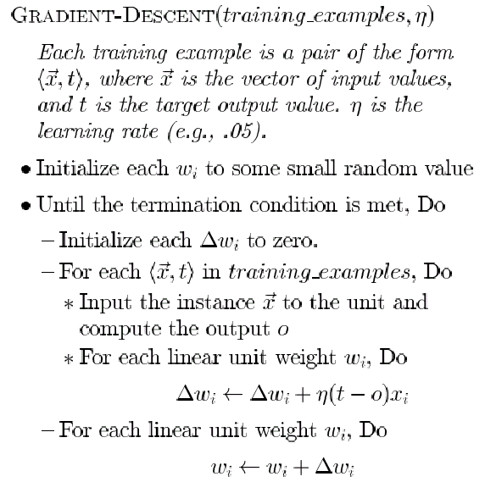
2.2. The Perceptron Training Rule (Continued)
Gradient-Descent Algorithm: →

Slide 40
Gradient-Descent Algorithm
To summarize, the gradient descent algorithm for training linear units is as follows:
Pick an initial random weight vector. Apply the linear unit to all training examples, then compute delta-wi for each weight
Update each weight wi by adding delta-wi, then repeat this process.
Because the error surface contains only a single global minimum, this algorithm will converge to a weight vector with minimum error, regardless of whether the training examples are linearly separable

Slide 41
stochastic gradient descent
The key practical difficulties in applying gradient descent.
converging to a local minimum can sometimes be quite slow.
if there are multiple local minima in the error surface, then there is no guarantee that the procedure will find the global minimum.
One common variation on gradient descent intended to alleviate these difficulties is called incremental gradient descent, or alternatively stochastic gradient descent.
The idea behind stochastic gradient descent is to approximate this gradient descent search by updating weights incrementally, following the calculation of the error for each individual example.

Slide 42


stochastic gradient descent
The modified training rule is
error function defined for each individual training example d as follows

Slide 43
stochastic gradient descent
The key differences between standard gradient descent and stochastic gradient descent are:
The training rule is known as the delta rule, or sometimes the LMS (least-mean-square) rule, Adaline rule, or Widrow-Hoff rule (after its inventors).
Standard gradient descent | Stochastic gradient descent
1.Weights are updated upon examining all training example. | 1.Weights are updated upon examining each training example.
2. Standard gradient descent requires more computation per weight update step. | 2. Stochastic gradient descent requires less computation per weight update step.

Slide 44
Remarks
Perceptron training rule
1.Updates weights based on the error in the thresholded perceptron output
2.converges after a finite number of iterations to a hypothesis that perfectly classifies the training data, provided the training examples are linearly separable.
Delta rule
1. Updates weights based on the error in the un-thresholded linear combination of inputs
2. converges only asymptotically toward the minimum error hypothesis, possibly requiring unbounded time, but converges regardless of whether the training data are linearly separable.

Slide 45
3. Multilayer Networks
The kind of multilayer networks learned by the BACKPROPACATION algorithm are capable of expressing a rich variety of nonlinear decision surfaces.
It is possible for the multilayer network to represent highly nonlinear decision surfaces that are much more expressive than the linear decision surfaces.
For example, in figure 3.0. the speech recognition task involves distinguishing among 10 possible vowels, all spoken in the context of "h-d" (i.e., “hid”, “had”, “head”, “hood”, etc.).

Slide 46
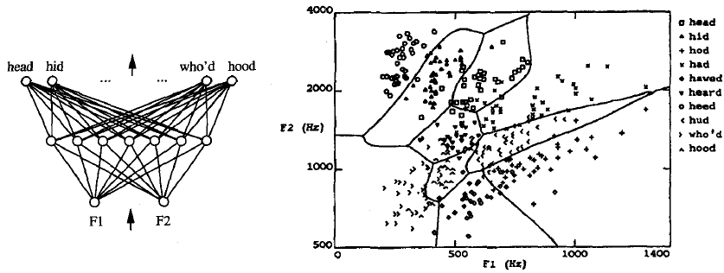
3. Multilayer Networks (Continued)
Figure 3.0.
The network input consists of two parameters, F1 and F2, obtained from a spectral analysis of the sound. The 10 network outputs correspond to the 10 possible vowel sounds. The plot on the right illustrates the highly nonlinear decision surface.

Slide 47
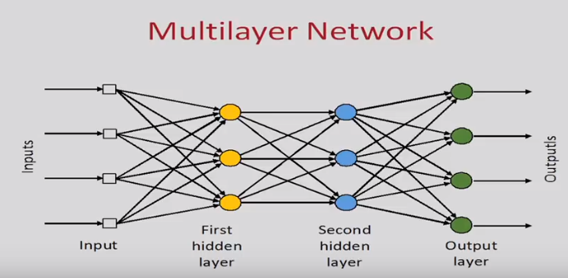

Slide 48
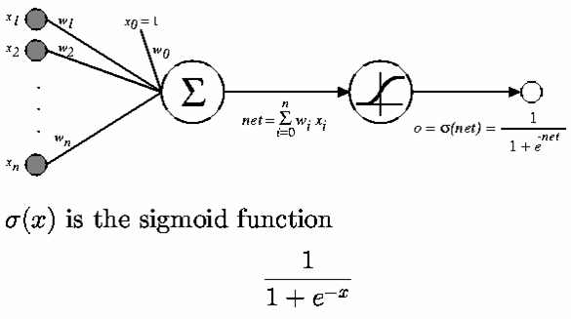
3. Multilayer Networks (Continued)
A Differentiable Threshold Unit:
Like the perceptron, the sigmoid unit first computes a linear combination of its inputs, then applies a threshold to the result. In the case of sigmoid unit, however, the threshold output is a continuous function of its input. The sigmoid function σ(x) is also called the logistic function.

Slide 49

3. Multilayer Networks (Continued)
Interesting property:
Output ranges between 0 and 1, increasing monotonically with its input.
We can derive gradient decent rules to train
• One sigmoid unit
• Multilayer networks of sigmoid units ⇒ Backpropagation

Slide 50
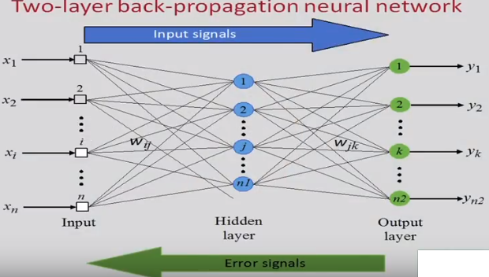

Slide 51
3. Multilayer Networks (Continued)
The Backpropagation (BP)Algorithm :
The BP algorithm learns the weights for a multilayer network, given a network with a fixed set of units and interconnections. It employs a gradient descent to attempt to minimize the squared error between the network output values and the target values for these outputs.
Considering networks with multiple output units rather than single units, redefine E to sum the errors over all of the network output units
E ( ) ((t_{kd} – o_{kd})²
where outputs is the set of output units in the network,
T_{kd} and o_{kd} are the target and output values associated with kth output unit and training example d.

Slide 52
The learning problem in Backpropagation is to search a large hypothesis space defined by all possible weight values for all the units in the network.
In multilayer network the error surface can have multiple local minima.
The gradient descent is guaranteed only to converge toward some local minimum, but not necessarily to global minimum error.

Slide 53
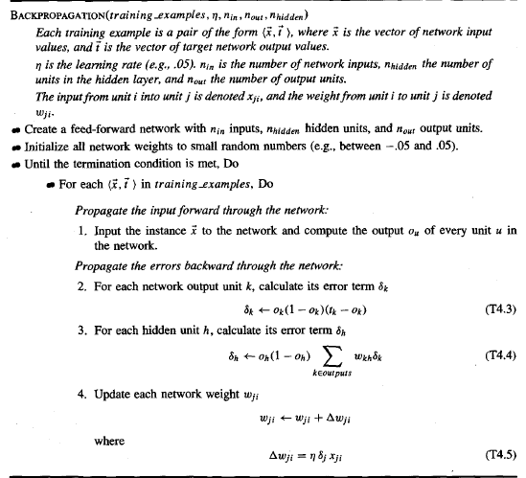
3. Multilayer Networks (Continued)

Slide 54
The algorithm here applies to layered feedforward networks containing two layers of sigmoid units, with units at each layer connected to all units from the preceding layer.
Notations :
An index(integer) is assigned to each node in the network, where a ‘node’ is either an input to the network or the output of some unit in the network.
x_{ji} denotes the input from node i to unit j , and w_{ji} denotes the corresponding weight.
_{n} denotes the error term associated with unit n. It plays a role similar to the quantity (t – o) in delta training rule. Where
_{n} =

Slide 55
Working of algorithm
The algorithm starts by constructing a network with the desired no. of hidden input and output units.
Initializing all network weights to small random values.
The main loop of the algorithm then repeatedly iterates over the training examples.
For each training example, it applies the network to the example, calculates the error of the network output for this example , the update all the weights in the network.
The gradient descent weight-update rule ( ) updates each weight in proportion to the learning rate ,the input value x_{ji} to which the weight is applied, and the error in the output of the unit.

Slide 56
The exact form of follows from the derivation of the weight-tuning rule.
is computed for each network output unit k as :
The factor is derivative of sigmoid squashing function.
value for each hidden unit h is calculated as
Training examples provide target values tk only for network output,no target values are directly available to indicate the error of hidden unit’s values.

Slide 57
Error term for hidden unit h is calculated by summing the error terms for each output unit influenced by h, weighing each of the ‘s by w_{kh,} the weight from hidden unit h to output unit k.
The weight characterizes the degree to which from hidden unit h is ‘responsible for’ the error in output unit k.
the algorithm updates weights incrementally , following the presentation of each training example.
The true gradient of E one would sum the values over all training examples before altering weight values.

Slide 58
The weigh-update loop in BackPropagation may be iterated thousands of times in a typical application.
The termination conditions are
i) after fixed number of iterations through the loop or,
ii) once the error on the training examples falls below some threshold or,
iii) once the error on a separate validation set of examples meet some criterion.
The choice of termination plays important role, as few no of iterations can fail to reduce error and too many can lead to overfitting the training data.

Slide 59
Adding Momentum
We can alter the weigh-update rule in
in the algorithm by making the weight update on the n^{th} iteration depend partially on the update that occurred during (n-1)th iteration, as follows :
is the weight update performed during the n^{th} iteration
is a constant called the momentum.
On RHS of the equation :
first term is just weight-update equation of Backpropagation algorithm,second term is new and called as momentum term

Slide 60
Learning in arbitrary acyclic networks
The Backpropagation easily generalizes to feedforward networks of arbitrary depth.
The weight update rule : is used ,with small changes in computing of values.
The general equation for computing is :
value for a unit ‘r’ in layer ‘m’ is computed from the values at the next deeper layer m + 1 .

Slide 61
We can generalize the algorithm to any directed acyclic graph, regardless of whether the network units are arranged in uniform layers or not.
The rule for calculating for any internal unit is
where Downstream(r) is the set of units immediately downstream from unit ‘r’ in the network i.e all units whose inputs include the output of unit ‘r’.

Slide 62
Derivation of the Backpropagation Rule
We will derive the weight-tunning rule of Back-propagation algorithm.
First we will derive the stochastic gradient descent rule implemented by the algorithm.
The stochastic gradient descent involves iterating through the training examples one at a time, for each training example d descending the gradient of the error E_{d} w.r.t this single example.
For each training example d every weight w_{ji} is updated by adding to it is updated by adding to it

Slide 63
where Ed is the error on training example d
Summing over all output units in the network 2
Here,
outputs is the set of units in the network,
t_{k} is the traget value of unit k for training example d

Slide 64
Subscripts and variables used in notation of stochastic gradient descent rule:
i -> i^{th} input
J -> j^{th} unit of the network
x_{ji} -> the i^{th} input to unit j
W_{ji} -> the weight associated with i^{th} input to unit j
net_{j} -> ( the weighted sum of inputs for
unit j)
oj -> the output computed for unit j
tj -> the target output for unit j
-> the sigmoid function
outputs -> the set of units in the final layer of the network

Slide 65
Downstream(j) = the set of units whose immediate inputs include the 0utput of unit j
In order to implement the stochastic gradient rule , we will derive an expression for
The weight w_{ji} can influence the rest of network only through net_{j} .
Using chain rule :
Now we have to derive a convenient expression for

Slide 66

ADVANCED TOPICS IN ARTIFICIAL NEURAL NETWORKS
Alternative Error Functions:
gradient descent can be performed for any function E that is differentiable with respect to the arameterized hypothesis space. While the basic BP algorithm defines E in terms of the sum of squared errors of the network, other definitions have been suggested in order to incorporate other constraints into the weight-tuning rule.
Examples of alternative definitions of E include:
1. Adding a penalty term for weight magnitude. we can add a term to E that increases with the magnitude of the weight vector. This causes the gradient descent search to seek weight vectors with small magnitudes, thereby reducing the risk of overfitting. One way to do this is to redefine E as

Slide 67


2. Adding a term for errors in the slope, or derivative of the target function. In some cases, training information may be available regarding desired derivatives of the target function, as well as desired values.
3. Minimizing the cross entropy of the network with respect to the target values. Consider learning a probabilistic function, such as predicting whether a loan applicant will pay back a loan based on attributes such as the applicant's age and bank balance. Although the training examples exhibit only boolean target values, the underlying target function might be best modeled by outputting the probability that the given applicant will repay the loan, rather than attempting to output the actual 1 and 0 value for each input instance. probability estimates that are given by the network that minimizes the cross entropy, defined as

Slide 68
4. Altering the effective error function can also be accomplished by weight sharing, or "tying together" weights associated with different units or inputs. For example, in an application of neural networks to speech recognition, the various units that receive input from different portions of the time window are forced to share weights. Such weight sharing is typically implemented by first updating each of the shared weights separately within each unit that uses the weight, then replacing each instance of the shared weight by the mean of their values.

Slide 69
Alternative Error Minimization Procedures
While gradient descent is one of the most general search methods for finding a hypothesis to minimize the error function, it is not always the most efficient. It is not uncommon for BP to require tens of thousands of iterations through the weight update loop when training complex networks. For this reason, a number of alternative weight optimization algorithms have been proposed and explored.
One optimization method, known as line search, involves a different approach to choosing the distance for the weight update. once a line is chosen that specifies the direction of the update, the update distance is chosen by finding the minimum of the error function along this line.
A second method, that builds on the idea of line search, is called the conjugate gradient method. Here, a sequence of line searshes is performed to search for a minimum in the error surface. On the first step in this sequence, the direction chosen is the negative of the gradient. On each subsequent step, a new direction is chosen so that the component of the error gradient that has just been made zero, remains zero.

Slide 70
Recurrent Networks
Recurrent networks are artificial neural networks that apply to time series data and that use outputs of network units at time t as the input to other units at time t + 1. In this way, they support a form of directed cycles in the network.
consider the time series prediction task of predicting the next day's stock market average y(t + 1 ) based on the current day's economic indicators x(t). Given a time series of such data, one obvious approach is to train a feedforward network to predict y(t + 1 ) as its output, based on the input values x(t). Such a network is shown in Figure 4.11(a).
One limitation of such a network is that the prediction of y(t + 1 ) depends only on x(t) and cannot capture possible dependencies of y (t + 1 ) on earlier values of x.

Slide 71
if we wish the network to consider an arbitrary window of time in the past when predicting y(t+l), then a different solution is required. The recurrent network shown in Figure 4.1 1(b) provides one such solution. the input value c(t) to the network at one time step is simply copied from the value of unit b on the previous time step. this implements a recurrence relation. Many other network topologies also can be used to represent recurrence relations. For example, we could have inserted several layers of units between the input and unit b, and we could have added several context units in parallel where we added the single units b and c.
Figure 4.11(c), which shows the data flow of the recurrent network "unfolded in time. Here we have made several copies of the recurrent network, replacing the feedback loop by connections between the various copies. This large unfolded network contains no cycles. Therefore, the weights in the unfolded network can be trained directly using BP.

Slide 72
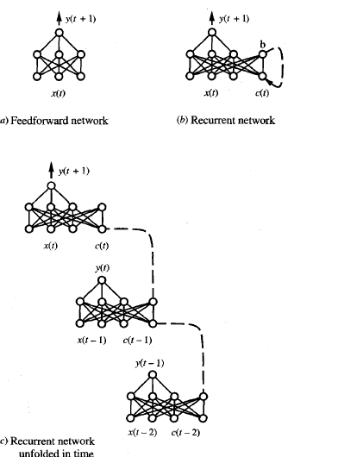

Slide 73
Dynamically Modifying Network Structure:
A variety of methods have been proposed to dynamically grow or shrink the number of network units and interconnections in an attempt to improve generalization accuracy and training efficiency.
One idea is to begin with a network containing no hidden units, then grow the network as needed by adding hidden units until the training error is reduced to some acceptable level. The CASCADE-CORRELATlON algorithm is one such algorithm.
A second idea for dynamically altering network structure is to take the opposite approach. Instead of beginning with the simplest possible network and adding complexity, we begin with a complex network and prune it as we find that certain connections are inessential. One way to decide whether a particular weight is inessential is to see whether its value is close to zero. A second way, which appears to be more successful in practice, is to consider the effect that a small variation in the weight has on the error E. The effect on E of varying w can be taken as a measure of the salience of the connection.

